Slide 1
Eco-Friendly Energy Usage Prediction
Predicting Household Energy Consumption using Machine Learning
Name – Ravya Mishra
PRN - 23030124063

Slide 2
Table of Contents
Introduction
Problem Statement
Dataset Description
System Architecture
Methodology
Model Comparisons
Eco Recommendation System
Model Performances
Future Scope
Conclusion

Slide 3
INTRODUCTION
Household energy consumption is rising rapidly
Manual monitoring is inefficient
Machine Learning enables predictive energy management

Slide 4
Why This Project Matters
Problem Statements
Buildings consume ~40% of global energy
HVAC & lighting often represent the largest controllable loads
Lack of predictive insight → inefficient usage & missed savings opportunities
Growing pressure on ESG reporting & carbon reduction targets
Solution Created
Predictive modeling of hourly energy consumption
Identification of high-leverage reduction levers
Quantifiable savings from rule-based interventions
Foundation for smart building optimization & demand response

Slide 5
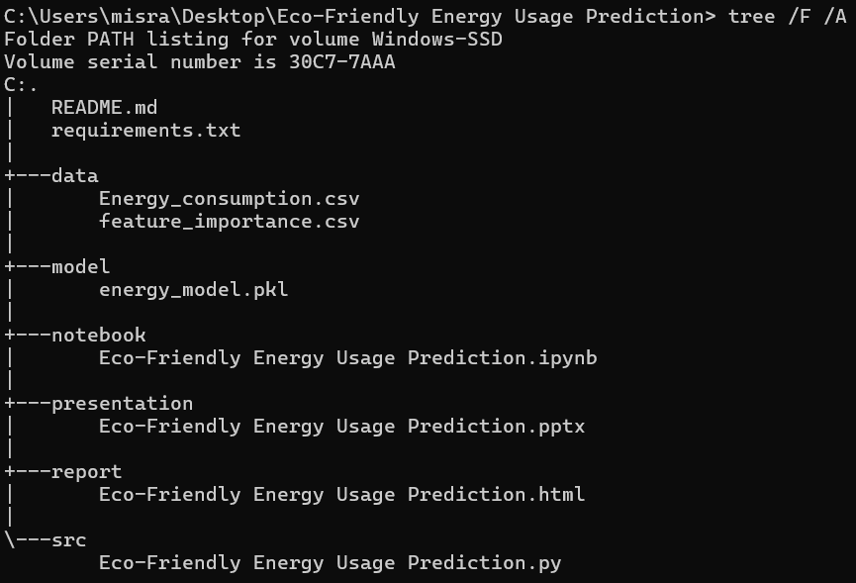
PROJECT DIRECTORY STRUCTURE
Modular separation of data, model, source code, and reports
Ensures maintainability and scalability
Facilitates reproducibility and version control using Git
Clear hierarchy for development and deployment

Slide 6
Dataset Description
Features:
Temperature
Humidity
SquareFootage
Occupancy
HVACUsage
LightingUsage
RenewableEnergy
DayOfWeek
Holiday
Timestamp
Target Feature: EnergyConsumption
Source: Energy_consumption.csv
~100,000 hourly observations
Target: EnergyConsumption (kWh)
10 raw features + engineered features

Slide 7
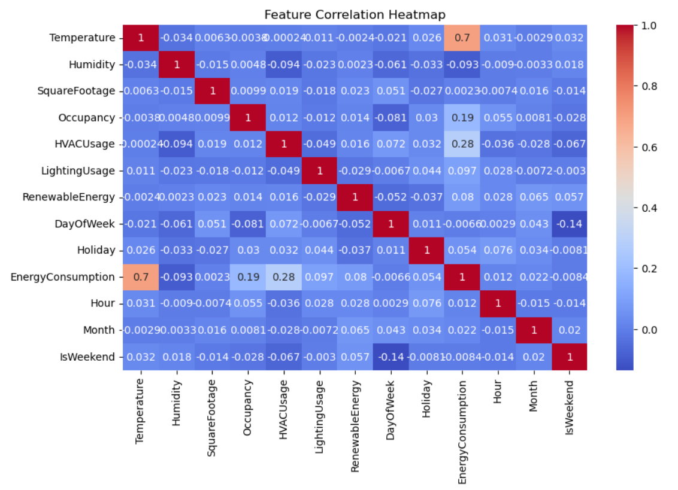
DATA EXPLORATION AND ANALYSIS
Dataset split into 80% training / 20% testing
Ensures model learns on unseen evaluation data
Prevents overfitting assessment bias
Provides realistic performance estimation
Random state fixed for reproducibility

Slide 8
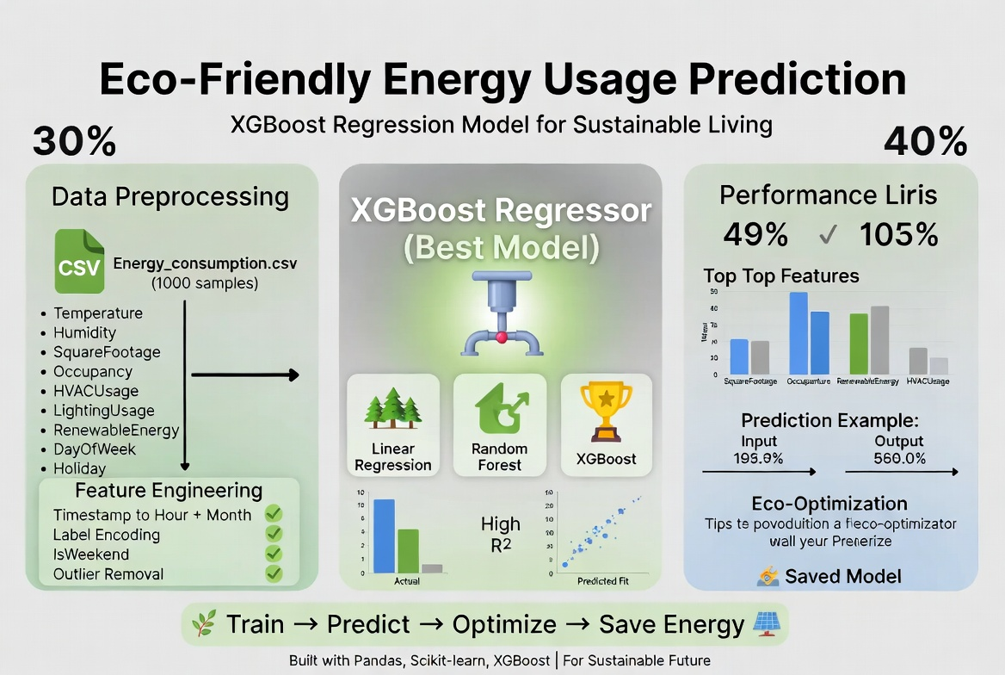
MODEL ARCHITECTURE

Slide 9
METHODOLOGY
Data Collection
Exploratory Data Analysis
Preprocessing
Feature Engineering
Model Training
Hyperparameter Tuning
Evaluation
Prediction & Optimization

Slide 10
Modelling Strategy & Model Comparison
MODEL | R² (TEST) | MAE | RMSE | TRAINING TIME | NOTES
LINEAR REGRESSION | ~0.65–0.75 | HIGHER | HIGHER | VERY FAST | BASELINE
RANDOM FOREST | ~0.85–0.92 | MEDIUM | MEDIUM | MODERATE | GOOD BUT OUTPERFORMED
XGBOOST | HIGHEST | LOWEST | LOWEST | MODERATE | SELECTED – BEST TRADEOFF

Slide 11
Final Model – XGBoost
pipe = Pipeline([
('scaler', StandardScaler()),
('model', XGBRegressor(**grid.best_params_))
])
params = {
'n_estimators':[100,200],
'max_depth':[3,5],
'learning_rate':[0.05,0.1]
}
Best Parameters: {'learning_rate': 0.05, 'max_depth': 3, 'n_estimators': 100}

Slide 12
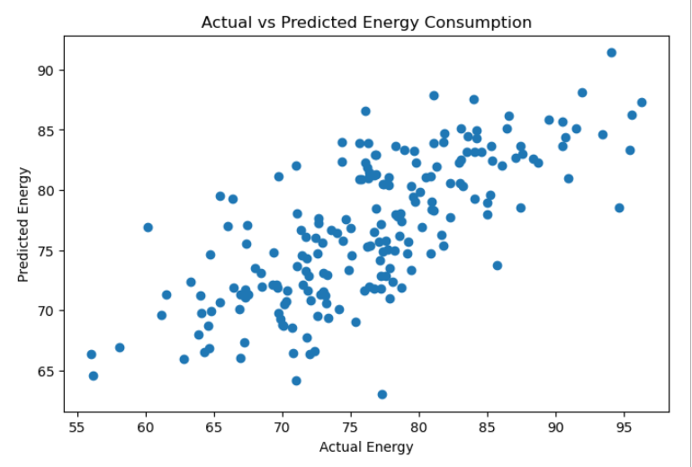
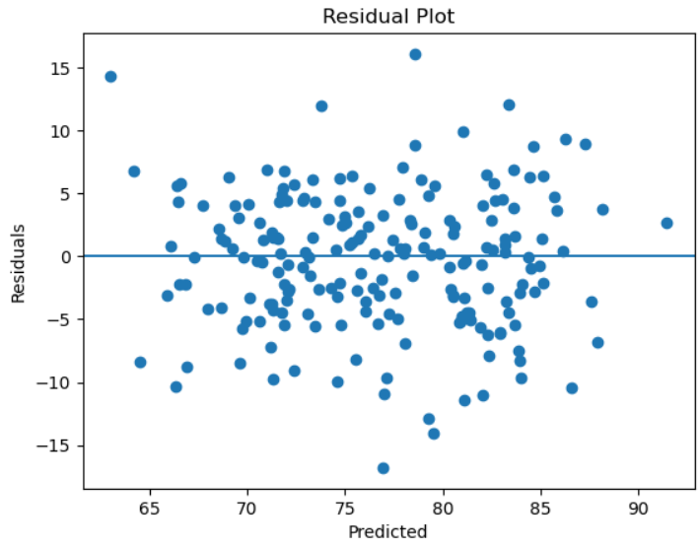
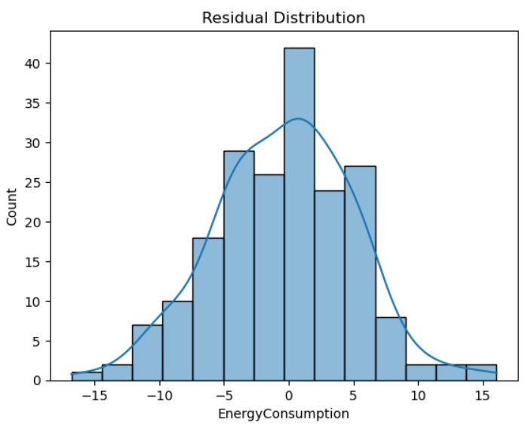
Model Performance
R² • MAE • RMSE • CV R² (5-fold)

Slide 13
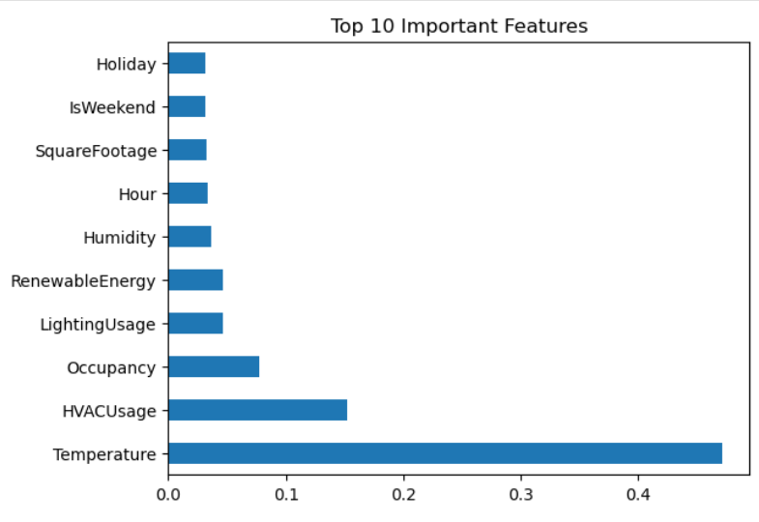
Feature Importance
Key insights
Building size is by far the strongest predictor
Controllable factors (HVAC, Lighting) appear high → strong intervention potential
Renewable contribution visible but secondary

Slide 14
From Prediction to Actionable Savings
Example case
Original prediction: 78.55 kWh → classified as High consumption
Recommendations triggered:
Turn off unnecessary HVAC
Switch off unused lighting
Simulated intervention:
HVACUsage = 0,
LightingUsage = 0 →
New prediction:
74.67 kWh → Relative reduction: 4.95%

Slide 15
Production Readiness & Next Steps
WHAT IS READY?
Trained & saved model (energy_model.pkl)
Clear feature importance ranking
Demonstrated intervention logic & savings quantification
Reproducible pipeline
LIMITATIONS & IMPROVEMENTS
Currently static simulation (not time-series aware)
No external weather forecast integration
Single building – not yet multi-site
Potential for time-series CV or LSTM comparison.

Slide 16
Data Science in Action for Sustainability
XGBoost delivered strongest predictive performance
Square footage, temperature & HVAC usage are dominant drivers
Simple operational changes can yield ~5% savings per instance
Model is saved, interpretable, and ready for integration
Clear path from prediction → behavioral recommendation → carbon impact
ACCURATE FORECASTING + TARGETED INTERVENTIONS = MEASURABLE PROGRESS TOWARD NET-ZERO BUILDINGS

Slide 17
THE END!
THANKYOU!!
ANY QUESTIONS…???
RAVYA MISHRA
23030124063

